Slide 1

Sports Analytics III
Produced by Dr. Mario
UNC STOR 538

Slide 2
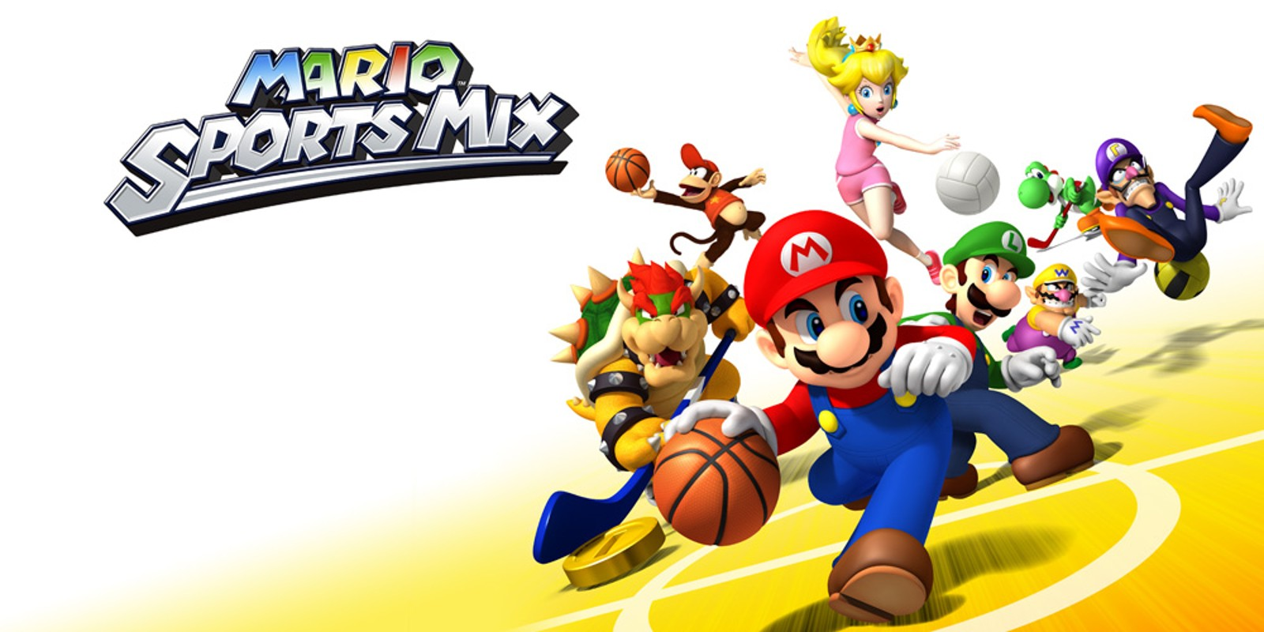
Industry Past
Sports Analytics Use Survey (2013)
Sample of 27 People (NFL, MLB, NBA, EPL)
How Many Different Sources?
1-2 (6.7%)
3-4 (33.3%)
5-6 (13.3%)
>6 (46.71%)

Slide 3
Industry Past
How Much Data is Centralized?
All (31.3%)
Most (37.4%)
Some (31.3%)
How Much Data is Dependent on One Person?
Some (50.0%)
Most (43.7%)
All Data Centralized (6.3%)

Slide 4
Industry Past
Is Data Checked for Errors?
Always (31.3%)
Usually (37.5%)
Sometimes (18.8%)
Occasionally (6.1%)
Rarely (6.3%)
How Many Database Programmers are Employed?
0 (37.5%)
1-2 (50.0%)
3-4 (0.0%)
>5 (12.5%)

Slide 5
Industry Past
How Many Statistical Analysts are Employed?
0 (20.0%)
1-2 (66.6%)
3-4 (0.0%)
>5 (13.3%)
Roadblock: Difficulty Identifying Strong Applicant
Difficulty in Both Hiring and Evaluating

Slide 6
Industry Past
Clear Process for Hiring/Evaluating Analysts
Strongly Agree (13.3%/14.3%)
Somewhat Agree (13.3%/14.3%)
Neutral (26.7%/28.6%)
Somewhat Disagree (13.4%/21.4%)
Strongly Disagree (33.3%/21.4%)
Analytic Resources in Line with Strategic Game Plan
Strongly Agree (26.7%)
Somewhat Agree (33.3%)
Neutral (33.3%)
Strongly Disagree (6.7%)

Slide 7
Industry Present
Article by Russell Karp (ITProPortal.com)
Global Sports Industry $600B-$700B (KPMG)
Including All Business Dedicated to Sports $1.3T
Global Sports Analytics Market
$2.43B
$135.23M
2016
2025
Projections in 2025 According to MarketWatch.com

Slide 8
Industry Present
Modern Applications of Sports Analytics
Helping the Team Win
Automated Video Analysis (Lincoln City, UK Football)
3D Depth Camera (NBA)
Wearable Technology (NBA, NHL)
Improving the Fan Experience
Analysis of Digital Engagement
Sentiment in Social Media
Analysis of Fan Behavior in Stadium (New England Patriots)
Wireless Internet and Phone Apps
Apps Supply Game Analytics, Parking Information, Promotions, and Traffic Information to the Fans (NFL)

Slide 9
Industry Present
Modern Applications of Sports Analytics
Benefiting Other Stakeholders
Tracking Fan Behavior Outside the Stadium
Telecommunication, Retailers, Payment Providers, Ticket Agencies, and Sponsorships
Adapt to Quick Changes in Consumer Behavior
Optimizing the Back-Office
HR Practices
Game Scheduling
Supply Chain Management and Logistics
Marketing and Promotions
Procurement of Goods and Services

Slide 10
Industry Present
Modern Applications of Sports Analytics
Advancing Sports Gambling
Supreme Court Ruling Previous Statute Violated 10th Amendment (Murphy v. National Collegiate Athletic Association)
States Free to Legislate Gambling
Improvement of Gambling Products
Data Aggregation and Visualization for Bettors
Develop Daily Fantasy Sports
Worth Over $5B According to Nevada Gaming Control Board (NGCB)

Slide 11
Your Industry Future
Prerequisites by Howard Hamilton
(Soccermetrics)
Technical Skills
Mathematics (Linear Algebra/Probability Essential)
Statistics (Frequentist and Bayesian Perspectives)
Machine Learning (Supervised and Unsupervised)
Programming (R/Python, Data Structures, OOP)
Databases
Visualization
Socials Skills, Ethics, and the Law
Knowledgeable About All Aspects of the Sport

Slide 12
Your Industry Future
Real Jobs (Indeed)
Baseball Analytics Intern for USA Baseball
Local Position in Cary
CS or Stats Background
R, SQL, Excel
Love of the Game
Analytics Internship for Arizona Coyotes
Dashboards in Tableau
Various Analytics Projects
SQL, R, Python

Slide 13
Your Industry Future
Real Jobs (Indeed)
Quantitative Sports Researcher for SIG
Build Statistical Forecasting Models
Implement Models and Simulate Outcomes
Demonstrated Experience with Sports Analytics Projects
Python, C++, Matlab and/or R
PhD Preferred
Operational Excellence Internship for FanDuel
SQL and Analytics
Love of the Game

Slide 14
Your Industry Future
Real Jobs (Indeed)
Valuation & Analytics Intern at IPG360
Build Content Database for Quarterly Insights Report
Market and Industry Research Assistance
3.0 GPA and Strong Software Skills (Microsoft Office)
Summer Intern for the NFL
Corporate Strategy and Data and Analytics
MBA Student
Coursework in CS, Math, Econometrics, etc.
SQL, SAS, Python, R, Big Data

Slide 15
Your Industry Future
Real Jobs (Indeed)
Analyst for the Cleveland Indians
Focus on Consumer Research and Insights
Bachelors Required is Business Related Field
Knowledge of SurveyGizmo, Qualtrics, etc.
Background with SQL or Tableau
Product Analyst for Turner
Work in Bleacher Report Department
Build and Maintain Reports/Dashboards
Exploratory Analyses for Deeper Understanding
SQL, Python, R, Tableau
Regression, Hypothesis Testing, Data Visualization

Slide 16
Your Industry Future
Real Jobs (Indeed)
Senior Analyst for Kagr LLC
Opportunity for Advanced Analytics in Sports
Revenue, Ticket Sales, Attendance Forecasting
Analytical Models and Machine Learning
Interest in Applying Statistical Methodology
Degree in Stats, Econ, Math, CS, etc.
R, Python, SQL Required
Sport Activity Experience Data Science Director
Test Products
Python and Deep Learning Libraries
Masters or PhD Preferred

Slide 17
Your Industry Future
Conferences
Sports Industry Networking and Career Conference, February 18-19
MIT Sloan Sports Analytics Conference, April 8-9
Basketball Analytics Summit, April 16
International Conference on Sports Analytics and Performance Evaluation, June 24-25
International Conference on Machine Learning and Data Mining for Sports, June 28-29
Disney Data & Analytics Conference, August 17-18
Sport & Entertainment Analytics Conference, TBD
Compiled by statsheetstuffers.com and sportsanalyticsconferences.com

Slide 18
Final Inspiration
Defense wins championships.
Offense wins contracts.
Be offensive.
- Mahatma Mario

